Slide 1
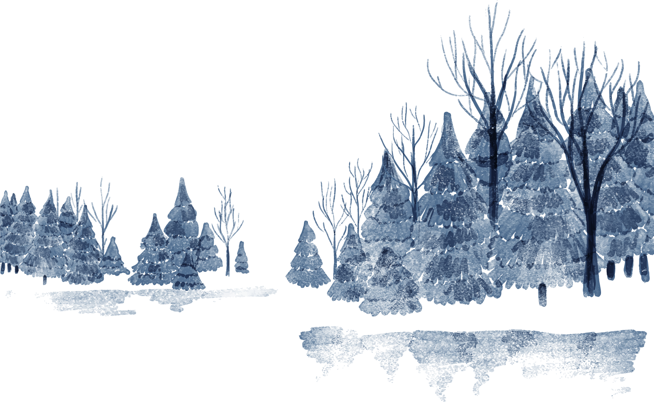
Bài toán bẻ ảnh
Captcha
DIPF22PRJ37

Slide 2

Members
Trương Thị Thu Hà Phạm Thị Thanh Hảo Thái Thuỳ Linh
DIPF22PRJ37
B19DCCN212
B19DCCN224
B19DCCN380

Slide 3
Table of contents
01
02
Introduction
Tools
03
04
Implement
Demo

Slide 4
01
Introduction
Bài toán bẻ ảnh Captcha

Slide 5
CAPTCHA
Completely Automated Public Turing test to tell Computers and Humans Apart

Slide 6
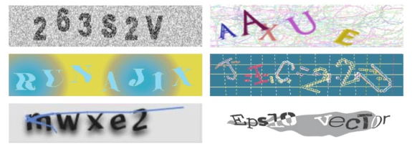
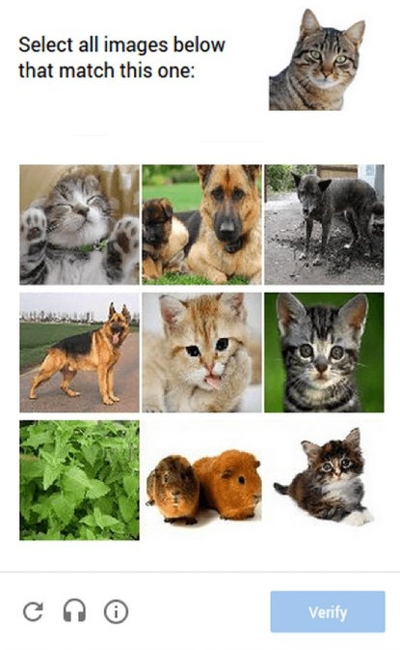
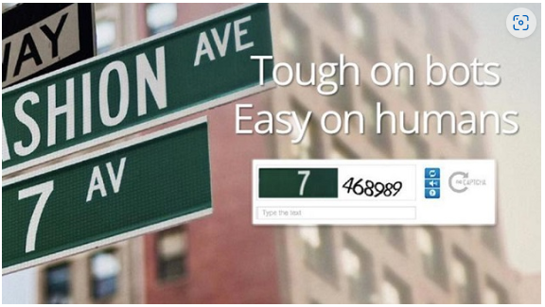
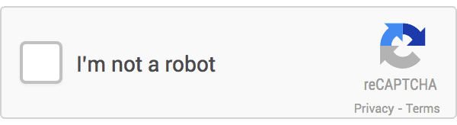
Captcha

Slide 7
02
Tools
Bài toán bẻ ảnh Captcha

Slide 8






Slide 9
03
Implement
Bài toán bẻ ảnh Captcha

Slide 10


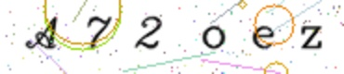

Captcha Generator
6 ký tự
Font chữ
Điểm màu
Đường thẳng
Đường tròn

Slide 11
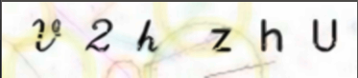
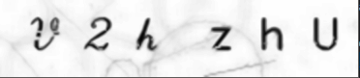
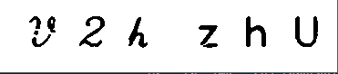
Digital Image Processing
Khử nhiễu
Chuyển đổi không gian màu
Phân ngưỡng
Cắt ảnh theo từng ký tự

Slide 12
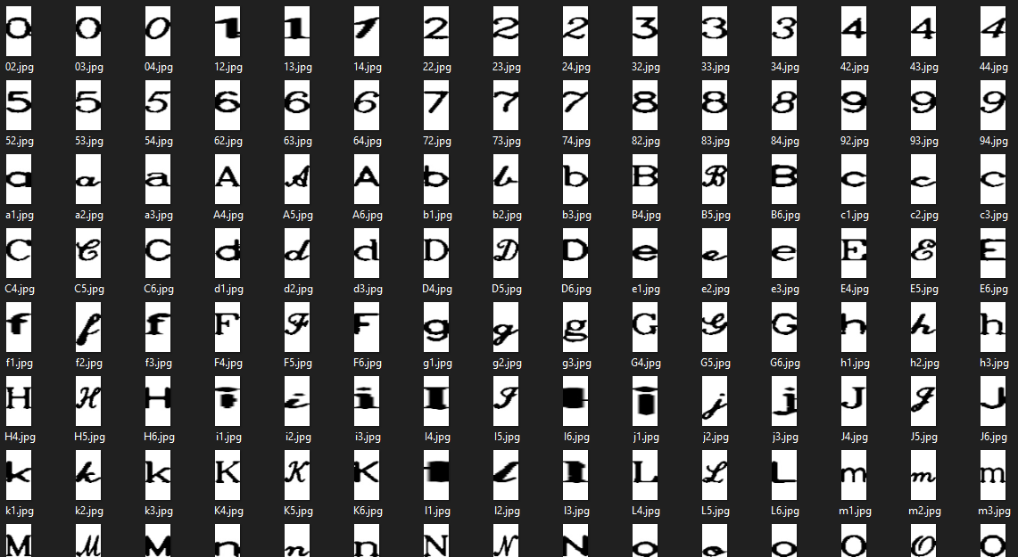
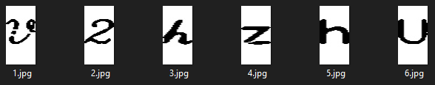
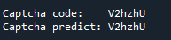
K – Nearest Neighbor
Data train
Input
Predict

Slide 13
04
Demo
Bài toán bẻ ảnh Captcha

Slide 14
Awesome words

Slide 15

Our history
Saturn
Neptune
Saturn is composed of hydrogen and helium
Neptune is the farthest planet from the Sun
2009
2011
2015
2021
Venus
Mars
Venus is the second planet from the Sun
Despite being red, Mars is actually a cold place

Slide 16
Come and feel part of nature
Mercury
Venus
Mercury is the closest planet to the Sun and the smallest one in the Solar System. This planet’s name has nothing to do with the liquid metal
Venus has a beautiful name and is the second planet from the Sun. It’s hot and is the second-brightest natural object in the night sky

Slide 17
Enjoy nature's gifts
Peace of mind
Silence
Energy
Mercury is the closest planet to the Sun and the smallest of them all
Despite being red, Mars is actually a cold place. It’s full of iron oxide dust
Venus has a beautiful name and is the second planet from the Sun

Slide 18
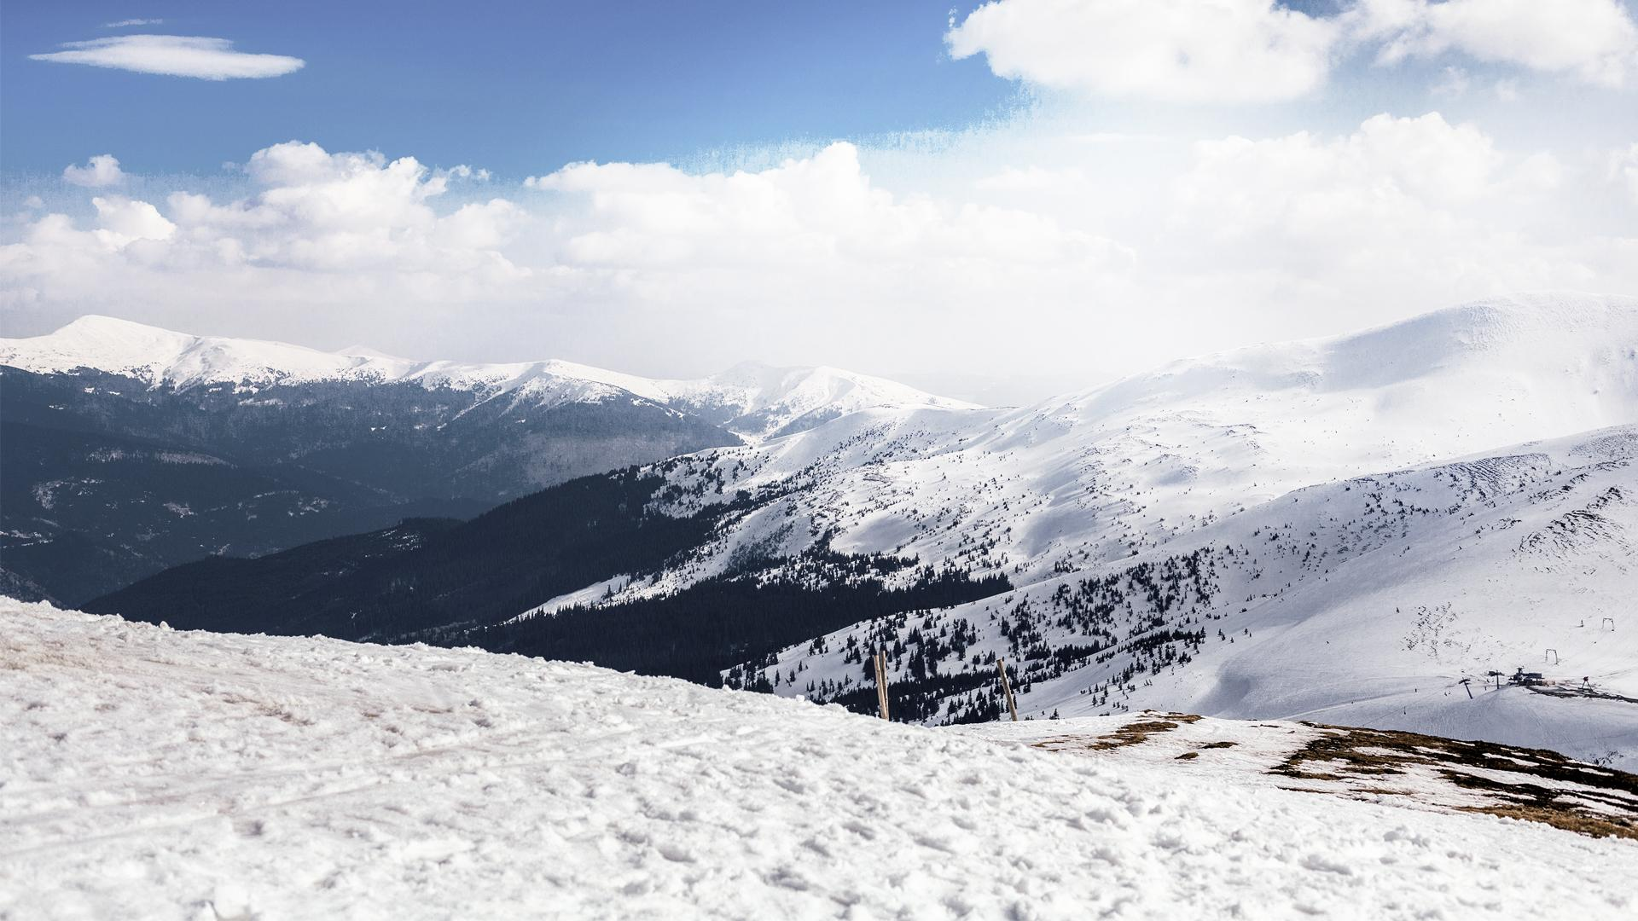
A picture is worth a thousand words

Slide 19
Top-rated attractions
Thredbo Village
Kosciuszko Walk
Charlotte Pass
Lake Jindabyne
Venus is the second planet from the Sun
Jupiter is the biggest planet in the Solar System
Despite being red, Mars is actually a cold place
Saturn is a gas giant and has several rings

Slide 20
Feeling adventurous?
Mercury
Venus
Mars
Jupiter
Saturn
Neptune
It’s the closest planet to the Sun and the smallest
Venus is the second planet from the Sun
Despite being red, Mars is actually a cold place
Jupiter is the biggest planet of them all
Saturn is composed of hydrogen and helium
Neptune is the farthest planet from the Sun

Slide 21
Where can you visit us?
Hotel
Mercury is the smallest planet
Resort
Venus is the second planet from the Sun

Slide 22
What can you do?
Activities
 | Mon to Sun | 9:00 am - 5:00 pm | $31.90
 | All week | 10:00 am - 6:00 pm | $15.40
 | Mon, Wed, Sun | 9:30 am - 4:00 pm | $492.80
 | All week | 11:00 am - 6:00 pm | $13.92

Slide 23
Ready to live your adventure?
Arrive at the hut
Ready? Go!
Get the map
Choose place
Venus is the second planet from the Sun
Mars is actually a cold place
Jupiter is the biggest planet of them all
Saturn is composed of hydrogen and helium

Slide 24
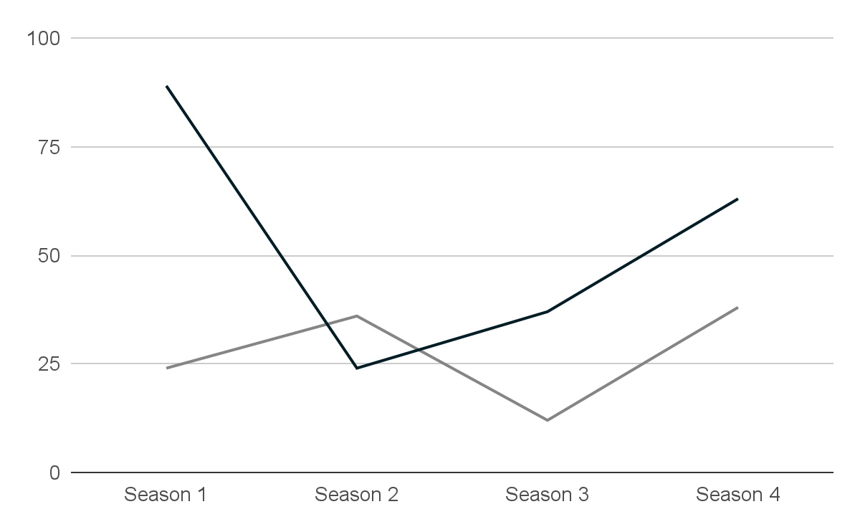
This is a graph
Mars
Despite being red, Mars is actually a cold place
Neptune
Neptune is the farthest planet from the Sun
Follow the link in the graph to modify its data and then paste the new one here. For more info, click here

Slide 25
21 million
Big numbers catch your audience’s attention

Slide 26
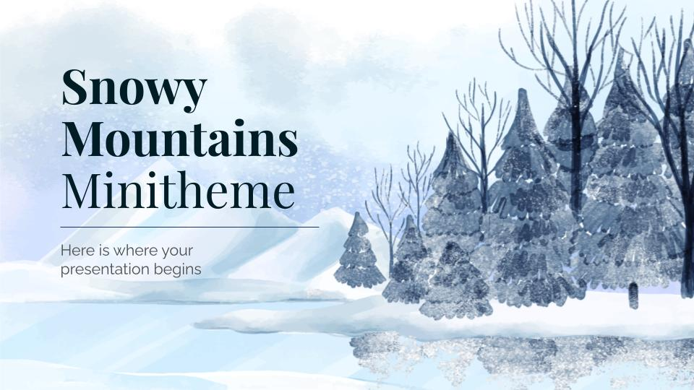
Product demo
You can replace the image on the screen with your own work. Just right-click on it and select “Replace image”

Slide 27
Thanks!
Do you have any questions?
youremail@freepik.com
+91 620 421 838
yourcompany.com
Please keep this slide for attribution

Slide 28
Outdoor activities icon pack

Slide 29
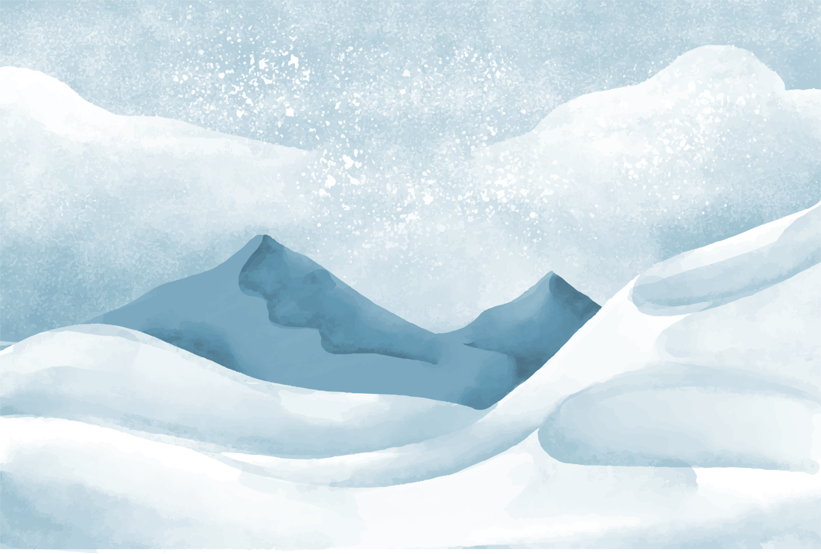
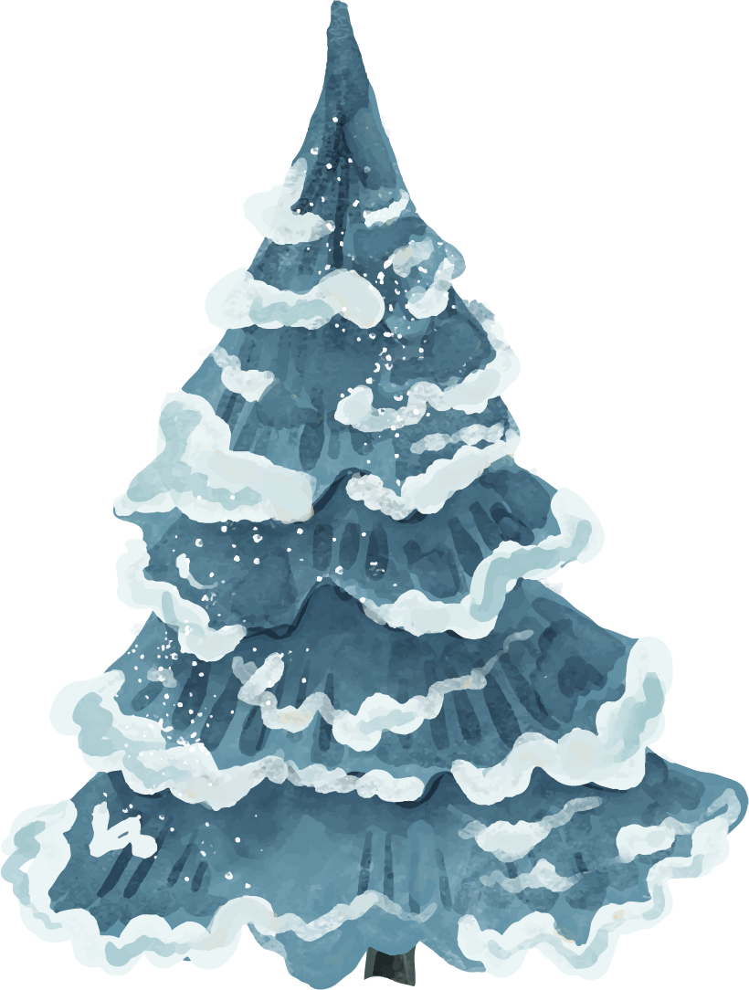
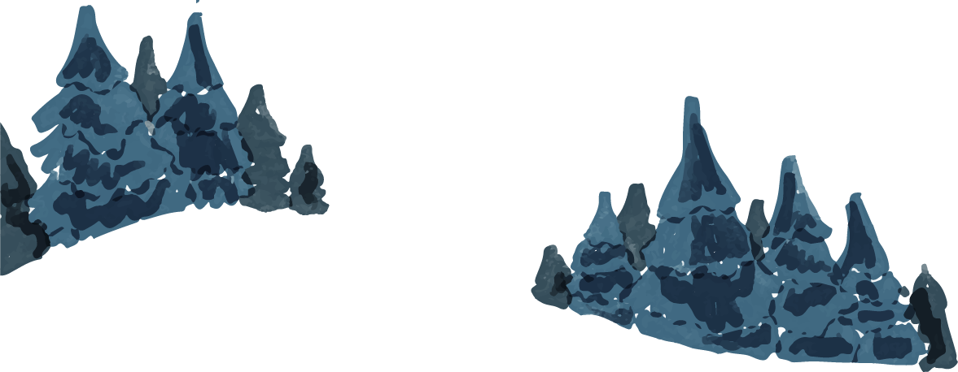
Alternative resources
Here’s an assortment of alternative resources whose style fits the one of this template

Slide 30
Resources
Here’s an assortment of alternative resources whose style fits the one of this template
Photos:
Spruce tree on a mountain hill covered with snow
Snowy mountain landscape against blue sky
An overhead view of snow covered trees in winter
Vectors:
Mountains and branches of trees winter landscape
Lake and trees winter landscape
Icons:
Icon Pack: Outdoor Activities

Slide 31
Instructions for use
In order to use this template, you must credit Slidesgo by keeping the Thanks slide.
You are allowed to:
- Modify this template.
- Use it for both personal and commercial projects.
You are not allowed to:
- Sublicense, sell or rent any of Slidesgo Content (or a modified version of Slidesgo Content).
- Distribute Slidesgo Content unless it has been expressly authorized by Slidesgo.
- Include Slidesgo Content in an online or offline database or file.
- Offer Slidesgo templates (or modified versions of Slidesgo templates) for download.
- Acquire the copyright of Slidesgo Content.
For more information about editing slides, please read our FAQs or visit Slidesgo School:
https://slidesgo.com/faqs and https://slidesgo.com/slidesgo-school

Slide 32
Instructions for use (premium users)
As a Premium user, you can use this template without attributing Slidesgo or keeping the "Thanks" slide.
You are allowed to:
Modify this template.
Use it for both personal and commercial purposes.
Hide or delete the “Thanks” slide and the mention to Slidesgo in the credits.
Share this template in an editable format with people who are not part of your team.
You are not allowed to:
Sublicense, sell or rent this Slidesgo Template (or a modified version of this Slidesgo Template).
Distribute this Slidesgo Template (or a modified version of this Slidesgo Template) or include it in a database or in any other product or service that offers downloadable images, icons or presentations that may be subject to distribution or resale.
Use any of the elements that are part of this Slidesgo Template in an isolated and separated way from this Template.
Register any of the elements that are part of this template as a trademark or logo, or register it as a work in an intellectual property registry or similar.
For more information about editing slides, please read our FAQs or visit Slidesgo School:
https://slidesgo.com/faqs and https://slidesgo.com/slidesgo-school

Slide 33
Fonts & colors used
This presentation has been made using the following fonts:
Playfair Display
(https://fonts.google.com/specimen/Playfair+Display)
Raleway
(https://fonts.google.com/specimen/Raleway)
#001c25
#ffffff
#4d4d4d
#7a7a7a
#263d63

Slide 34





Storyset
Create your Story with our illustrated concepts. Choose the style you like the most, edit its colors, pick the background and layers you want to show and bring them to life with the animator panel! It will boost your presentation. Check out How it works.
Pana
Amico
Bro
Rafiki
Cuate

Slide 35
Use our editable graphic resources...
You can easily resize these resources without losing quality. To change the color, just ungroup the resource and click on the object you want to change. Then, click on the paint bucket and select the color you want. Group the resource again when you’re done. You can also look for more infographics on Slidesgo.

Slide 38
JANUARY
FEBRUARY
MARCH
APRIL
MAY
JUNE
PHASE 1
Task 1
Task 2
PHASE 2
Task 1
Task 2
JANUARY
FEBRUARY
MARCH
APRIL
PHASE 1
Task 1
Task 2

Slide 41
...and our sets of editable icons
You can resize these icons without losing quality.
You can change the stroke and fill color; just select the icon and click on the paint bucket/pen.
In Google Slides, you can also use Flaticon’s extension, allowing you to customize and add even more icons.

Slide 42
Educational Icons
Medical Icons

Slide 43
Business Icons
Teamwork Icons

Slide 44
Help & Support Icons
Avatar Icons

Slide 45
Creative Process Icons
Performing Arts Icons

Slide 46
Nature Icons

Slide 47
SEO & Marketing Icons

Slide 48


